Slide 1
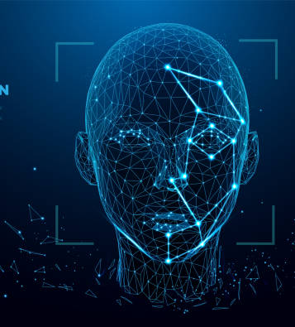
Face Recognition Using Dynamic Time Wrapping Algorithm
Computation intelligence
Prof. Andreas Pech
Submitted by :
Muhammad Haris (1440274)
Yatish Sharma(1457597)

Slide 2
Summary
Existing Profile Recognition Challenges:
Dependence on accurate fiducial point identification.
Challenges in detecting points due to unique facial characteristics (e.g., flat chin, projecting lips, concave nose).
Fiducial point quantity and location variations with changing facial expressions.
Innovative Approach:
Introduction of a shape predictor using landmark matching.
Focus on utilizing profile data instead of traditional fiducial point extraction.
Application of dynamic time warping for face profile matching from nasion to throat.
Experimental validation on profile face image databases.

Slide 3
Literature Review
Significance of Facial Profile:
The facial profile provides an additional structural view for face recognition.
Simplicity and reliability in assessing facial profiles compared to frontal views.
Previous Approaches:
Dependency on accurate fiducial point identification and their associations.
Tangency-based methods for reference point selection but limited applicability (e.g., protruding lips).
Landmark detection approaches, invariant to rotation, translation, and scaling.
Utilization of scale space for analyzing profile features and deriving fiducials.
Extraction of face descriptors from 3D range photos, considering depth and curvature.
Advancements:
Transition from traditional fiducial-based approaches to landmark-based methods.
Overcoming limitations of tangency-based techniques.
Utilization of 3D range images for accurate pronasale and nasion extraction.
Incorporation of high-level sets of depth and curvature relationships for face recognition.

Slide 4
Methodology
Challenges in Fiducial Point Extraction
Numerous techniques for fiducial point identification.
Inconsistent extraction due to diverse facial profiles.
Variation in isolated fiducials over the years.
Dynamic Wrapping Algorithm for Face Recognition
Collection of training dataset images.
Extraction of facial landmarks in the dataset.
Establishment of a model database with training dataset landmarks.
Dynamic Time Warping (DTW) applied to facial profile region (nose to throat) based on landmark values.
DTW chosen for reliable time series distance measurement.

Slide 5


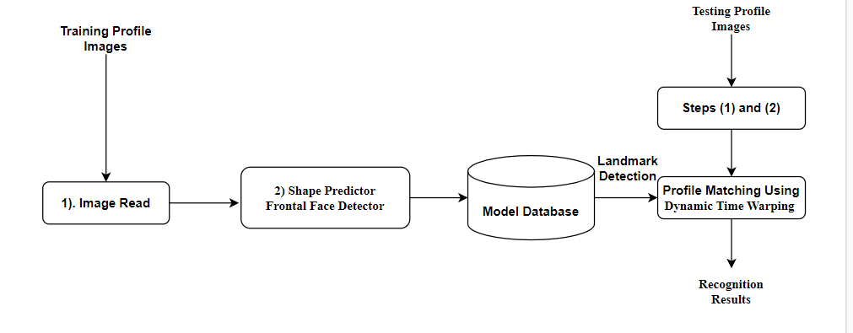



Block Diagram:

Slide 6
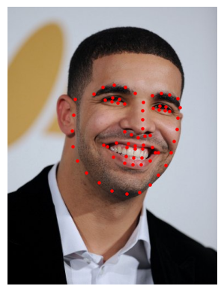
1. Facial Landmark Technique
Utilization of facial landmarks for fiducial point extraction.
Landmarks include brows, eyes, jaw, nose, and mouth.
Applications: face alignment, head posture estimation, blink detection, and more.
Emphasis on facial structure identification using shape prediction.
2. Profile Matching using Dynamic Time Warping
DTW as the approach for comparing sequences of varying length.
Absolute curvature values used to describe facial contours.
Ideal alignment determined with Needleman-Wunsch global alignment.
Calculation of DTW distance for similarity assessment.
Euclidean distance for measuring the similarity between facial profiles.
Penalty adjustments for vertical and horizontal gaps.
Final alignment score (D(m, n)) for profile matching.

Slide 7
Experiment Setup
Utilized celebrity dataset with varying angles and expressions.
Applied the dynamic wrapping algorithm to compute distances between images.
Examined four different actors with images from separate events, angles, and expressions.
Set the distance recognition threshold at 5, considering variations due to photo angles.
Results Overview
For Threshold of 5 For Threshold of 10
Actor Name | DTW Distance | Result
Angelina Jolie | 2.75 | Face Recognized
Brat Pitt | 9.19 | Face Not Recognized
Jhonny Depp | 4.98 | Face Recognized
Drake | 7.38 | Face Not Recognized
Actor Name | DTW Distance | Result
Angelina Jolie | 2.75 | Face Recognized
Brat Pitt | 9.19 | Face Recognized
Jhonny Depp | 4.98 | Face Recognized
Drake | 7.38 | Face Recognized

Slide 8

Conclusion
Presented a Facial Landmarks technique for face recognition.
Utilized profile information stored in the model database.
Employed dynamic time warping (DTW) for matching facial profile portions.
Adaptability demonstrated, even for profiles with significant expression variations.
Slight susceptibility to noise, with potential for improvement through precise verification methods.

